Slide 1

INSTITUTE - UIE
DEPARTMENT- ACADEMIC UNIT-2
Bachelor of Engineering (Computer Science & Engineering)
Subject Name: Object Oriented Programming using C++
Code:20CST151
Unit-1
Topic: Inline function
DISCOVER . LEARN . EMPOWER

Slide 2


Object Oriented Programming using C++
Course Objectives
To enable the students to understand various stages and constructs of C++ programming language and relate them to engineering programming problems.
To improve their ability to analyze and address variety of problems in programming domains.

Slide 3



Course Outcomes
CO Number | Title | Level
CO1 | Provide the environment that allows students to understand object-oriented programming Concepts. | Understand
CO2 | Demonstrate basic experimental skills for differentiating between object-oriented and procedural programming paradigms and the advantages of object-oriented programs. | Remember
CO3 | Demonstrate their coding skill on complex programming concepts and use it for generating solutions for engineering and mathematical problems. | Understand
CO4 | Develop skills to understand the application of classes, objects, constructors, destructors, inheritance, operator overloading and polymorphism, pointers, virtual functions, exception handling, file operations and handling. | Understand

Slide 4
Scheme of Evaluation
Sr. No. | Type of Assessment Task | Weightage of actual conduct | Frequency of Task | Final Weightage in Internal Assessment (Prorated Marks) | Remarks
1. | Assignment* | 10 marks of each assignment | One Per Unit | 10 marks | As applicable to course types depicted above.
2. | Time Bound Surprise Test | 12 marks for each test | One per Unit | 4 marks | As applicable to course types depicted above.
3. | Quiz | 4 marks of each quiz | 2 per Unit | 4marks | As applicable to course types depicted above.
4. | Mid-Semester Test** | 20 marks for one MST. | 2 per semester | 20 marks | As applicable to course types depicted above.
5. | Presentation*** |  |  | Non Graded: Engagement Task | Only for Self Study MNGCourses.
6. | Homework | NA | One per lecture topic (of 2 questions) | Non-Graded: Engagement Task | As applicable to course types depicted above.
7. | Discussion Forum | NA | One per Chapter | Non Graded: Engagement Task | As applicable to course types depicted above.
8. | Attendance and Engagement Score on BB | NA | NA | 2 marks

Slide 5
CONTENTS
Introduction to Inline Function
Advantages of inline function
Examples
Notes:
Computer in the diagram is 3rd generation computer. The period of third generation was from 1965-1971. The computers of third generation used Integrated Circuits (ICs) in place of transistors. A single IC has many transistors, resistors, and capacitors along with the associated circuitry. The main features of third generation are −
IC used
More reliable in comparison to previous two generations
Smaller size
Generated less heat
Faster
Lesser maintenance
Costly
AC required
Consumed lesser electricity
Supported high-level language

Slide 6
INLINE FUNCTION
Inline functions are actual functions, which are copied everywhere during compilation, like preprocessor macro, so the overhead of function calling is reduced. All the functions defined inside class definition are by default inline, but you can also make any non-class function inline by using keyword inline with them.
An inline function is expanded (i.e. the function code is replaced when a call to the inline function is made) in the line where it is invoked.
Syntax:
inline function_header
{
body of the function
}

Slide 7
INLINE FUNCTION
We must keep inline functions small, small inline functions have better efficiency.
Inline functions do increase efficiency, but we should not make all the functions inline. Because if we make large functions inline, it may lead to code bloat, and might affect the speed too.
Hence, it is adviced to define large functions outside the class definition using scope resolution :: operator, because if we define such functions inside class definition, then they become inline automatically.
Inline functions are kept in the Symbol Table by the compiler, and all the call for such functions is taken care at compile time

Slide 8
INLINE FUNCTION
The inlining does not work for the following situations :
1. For functions returning values and having a loop or a switch or a goto statement.
2. For functions that do not return value and having a return statement.
3. For functions having static variable(s).
4. If the inline functions are recursive (i.e. a function defined in terms of itself).

Slide 9
Inline functions provide following advantages:
1) Function call overhead doesn’t occur.
2) It also saves the overhead of push/pop variables on the stack when function is called.
3) It also saves overhead of a return call from a function.
4) When you inline a function, you may enable compiler to perform context specific optimization on the body of function. Such optimizations are not possible for normal function calls. Other optimizations can be obtained by considering the flows of calling context and the called context.

Slide 10
Example
#include<iostream>
using namespace std;
inline int Add(int x,int y)
{
return x+y;
}
int main()
{
cout<<"\n\tThe Sum is : " << Add(10,20);
cout<<"\n\tThe Sum is : " << Add(45,83);
cout<<"\n\tThe Sum is : " << Add(27,48);
}

Slide 11
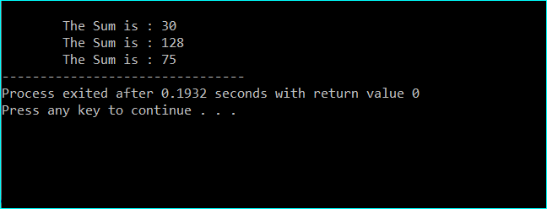
Output:

Slide 12
INLINE FUNCTION
It is also possible to define the inline function inside the class. In fact, all the functions defined inside the class are implicitly inline. Thus, all the restrictions of inline functions are also applied here.
If you need to explicitly declare inline function in the class then just declare the function inside the class and define it outside the class using inline keyword.

Slide 13
Example
#include <iostream>
using namespace std;
class operation
{
int a, b, add, sub;
public:
void get();
void sum();
void difference();
};
inline void operation :: get()
{
cout << "Enter first value:";
cin >> a;
cout << "Enter second value:";
cin >> b;
}

Slide 14
Example Contd…
inline void operation :: sum()
{
add = a+b;
cout << "Addition of two numbers: " << a+b << "\n";
}
inline void operation :: difference()
{
sub = a-b;
cout << "Difference of two numbers: " << a-b << "\n";
}

Slide 15
Example Contd…
int main()
{
cout << "Program using inline function\n";
operation s;
s.get();
s.sum();
s.difference();
return 0;
}

Slide 16
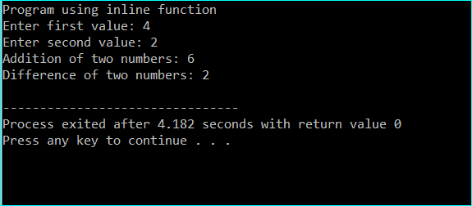
Output

Slide 17
Summary
In this lecture we have discussed about Inline Function.
We have discussed about Advantages of Inline Function
Discussed about examples of inline functions

Slide 18
Frequently Asked question
Q1 Define Inline Function.
Answer : When the function is defined Inline, the C++ compiler puts the function body inside the calling function. You can define function as Inline when the function body is small and need to be called many times, thus reduces the overhead in calling a function like passing values, passing control, returning values, returning control.

Slide 19
Q2 Do inline functions improve performance? Explain.
Answer: A function when defined as INLINE, the code from the function definition is directly copied into the code of the calling function.
It avoids the overhead of calling the actual function. This is because the complier performs and inline expansion which eliminates the time overhead when a function is called.
Reduces space as no separate set of instructions in memory is written.

Slide 20
Q3 When to use Inline function?
Answer: We can use Inline function as per our needs. Some useful recommendation are mentioned below-
We can use the inline function when performance is needed.
We can use the inline function over macros.
We prefer to use the inline keyword outside the class with the function definition to hide implementation details of the function.

Slide 21
Assessment Questions:
1. Pick the incorrect statement about inline functions in C++?
a) They reduce function call overheads
b) These functions are inserted/substituted at the point of call
c) Saves overhead of a return call from a function
d) They are generally very large and complicated function
2. Inline functions are avoided when ____________________________
a) function contains static variables
b) function have recursive calls
c) function have loops
d) all of the mentioned

Slide 22
3 . Pick the correct statement.
a) Macros and inline functions are same thing
b) Macros looks like function calls but they are actually not
c) Inline functions looks like function but they are not
d) Inline function are always large
4. Which functions of a class are called inline functions?
a) All the functions containing declared inside the class
b) All functions defined inside or with the inline keyword
c) All the functions accessing static members of the class
d) All the functions that are defined outside the class
5. Which of the following is a valid inline for function foo?
A. inline void foo() {}
B. void foo() inline {}
C. inline:void foo() {}
D. None of the above

Slide 23
Discussion forum.
Write a C++ program to perform different arithmetic operation such as addition, subtraction, division, modulus and multiplication using inline function.

Slide 24

REFERENCES
Reference Books
[1] Programming in C by Reema Thareja.
[2] Programming in ANSI C by E. Balaguruswamy, Tata McGraw Hill.
[3] Programming with C (Schaum's Outline Series) by Byron Gottfried Jitender Chhabra, Tata McGraw Hill.
[4] The C Programming Language by Brian W. Kernighan, Dennis Ritchie, Pearson education.
Websites:
https://www.geeksforgeeks.org/inline-functions-cpp/
https://www.tutorialspoint.com/cplusplus/cpp_inline_functions.htm
https://www.educative.io/edpresso/what-is-a-cpp-inline-function
YouTube Links:
What is inline function? http://www.infocobuild.com/education/audio-video-courses/computer-science/ProgrammingInCpp-IIT-Kharagpur/lecture-08.html

Slide 25
THANK YOU

